Slide 1
Wine Rating Predictions Machine Learning:
ASSIGNMENT 1 – ORAL PRESENTATION
By: Darlene Phan
Coding Dojo – Data Science

Slide 2

The Client:
A global wine supplier.
The Problem:
Looking to expand their wine catalogue by being able to rate potential new wines. Starting with Spanish wines
Our Mission:
To build a machine learning model that will help predict wine ratings based on its characteristics. This will allow our client can easily determine what new wines will have a place in their inventory.
Notes:
For this assignment, the client is a global wine supplier looking for a way to expand their catalogue by rating potential new wines.
What we can do for them. Build a machine learning model based on their current inventory and customer reviews to accurately predict new wines. This will allow our client to swiftly determine what wines they should import.

Slide 3
Data Dictionary Breakdown
Country, Region & Vineyard
The geographical location vineyard the wine comes from. Also known as winery.
Body(scale 1-5) & Acidity (scale 1-3)
Body determines the weight or depth of the wine.
Acidity determines the tartness of the wine.
Price
Price per bottle of wine in Euros.
Wine Type & Wine Name
Type – Chardonnay, Grenache, Pinot Noir.
Wine Type as name – Trader Joes Charles Shaw Blend Merlot.
Rating (4.2-4.9)
Rating of the wine given by its number of users.
Vintage (year)
The year in which the grapes are harvested. N.V. stands for non-vintage, generally means the wines are a blend of multiple vintages.
Notes:
Quick breakdown of the data dictionary.
Country region and vineyard gives you the geographic location and the vineyard it’s at.
Price. Ratings, unsure on how low they went. I’m assuming 1-5 but all the ratings recorded were 4.2 – 4.9
Body on a scale of 1-5 and acidity was on a scale of 1-3. Body determines the weight or depth of the wine and acidity determine the tartness of the wine.
Wine type and wine names are sometimes one in the same. Type of wine like a chardonnay is made from chardonnay grapes. Wine names can be created by named by the winery or it can be the grapes themselves. like a trader joes charles shaw merlot.
Lastly, and something I think is very important when it comes to wine. Vintage, which is also known as year. This is the year in which the grapes are harvested. Sometimes you will find wines that will have an NV label on them which stands for non vintage. This means that the wines are usually a blend of multiple years and do not have a particular harvest year.

Slide 4
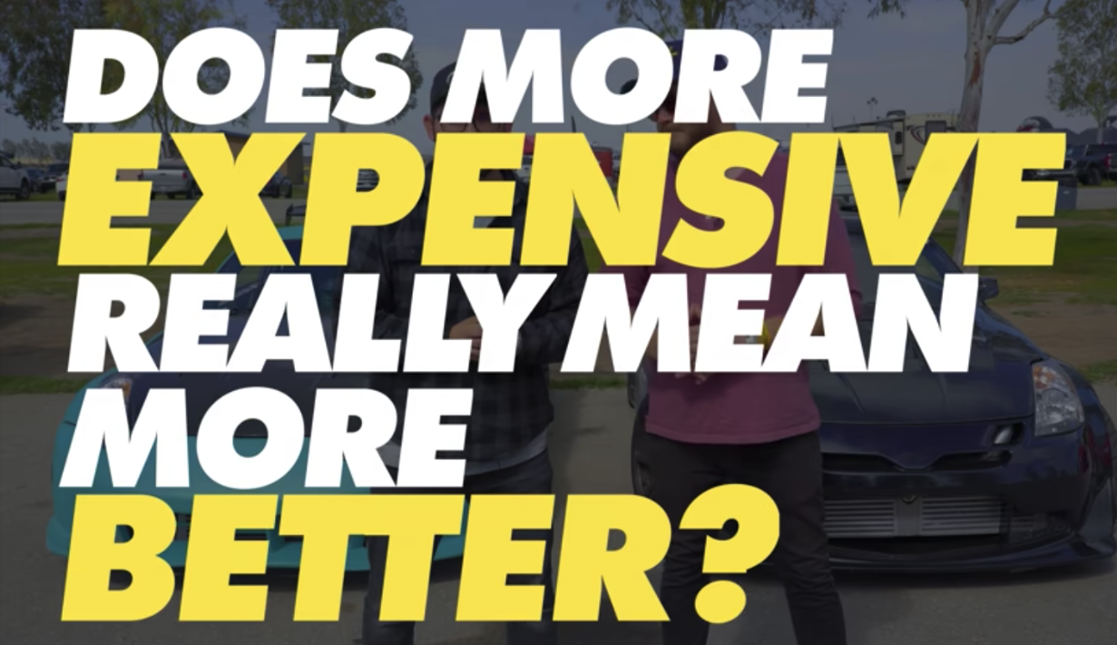
Unconscious Wine Bias
(Key Findings)
“But Darlene, I don’t have any biases when it comes to wine.”
Does an older vintage
=
more expensive wine?
Does expensive wine
=
higher rated wine?
Contrary to popular belief, more expensive does not mean more better. Nor does it mean that older wines = higher price tags.
Side note: It is very important to note that, although this is funny, there is an article I came across on LinkedIn that talks about how our unconscious bias is hindering the growth of Data Science.
Notes:
This next part is important for both data science and wine. I want to talk about your unconscious bias.
CLICK!
You might say, but Darlene I don't have any biases when it comes to wine. Are you sure?
Click
Does more expensive really mean more better?
CLICK!
Does an older vintage equal more expensive wine?
CLICK
and lastly does expensive wine = higher rated wines?
Click

Slide 5
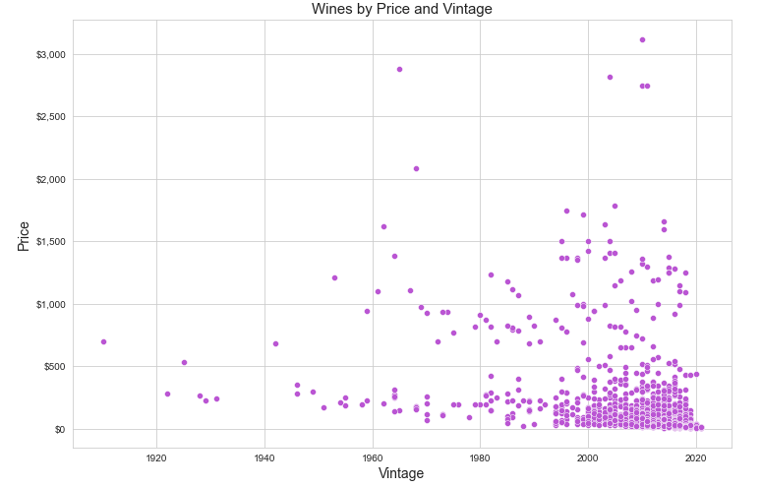
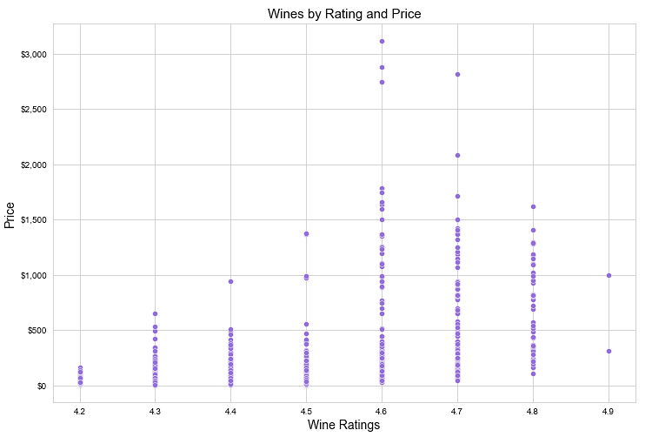



Vintages and Their Influence on Rating and Prices
(Key Findings)
Wine Vintages vs Prices:
Wine Rating vs Prices:
4 of 5 vintages are between 2005-2015
4 highest priced wines are rated at 4.7 or below.
Oldest wine vintage over 100 years old is under $1,000
2 highest rated wine are priced on par with lower priced wines.
Notes:
stuck
upward trend celling on pricing and drops at 4.7
our higest priced wines are only rated 4.6-4.7.
our highest rated wines are priced on par with lower rated wines. This lets us know that just because the wines are rated higher does necessarily mean that its going to be priced higher

Slide 6
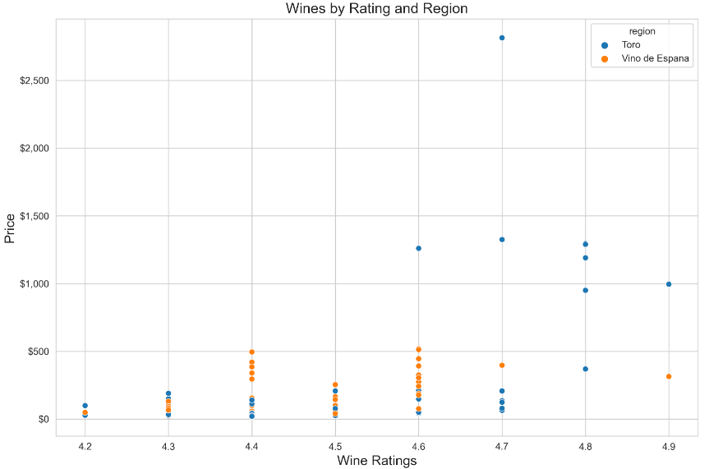

Model Limitations
Too Much Data and Not Enough Data
Too Many Categories Within Categories (Inception Categories):
704 different wineries
410 wine names
65 regions of Spain
793 reviews (not total reviews)
Having too many categories makes our machine learning model too specific, in turn makes it less accurate on making predictions.
Not Enough Data:
How our client rate wines compared to the users.
More characteristics to determine how wines should be rated.
Notes:
i wanted to find all possible holes. So this graph is a distribution regions of wine that produced the higest rated wines. it shows us that regardless of region, they still produce wines with a variety of ratings and pricing. so that rules out that region has an effect on how wines are rated

Slide 7
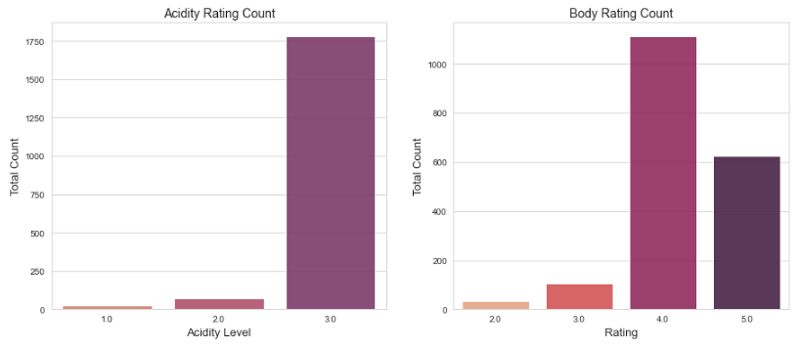
Models Strengths
Linear Regression Model
Model Evaluation Metrics:
R2 Score RMSE Score
Our score: 64%
The higher the score the better.
Our score: 0.1
The lower the score the better.
Strengths
The client can deploy the model now and cut down on potential workload by 64%. With some adjustments to the model, there’s room to reduce labor by increasing the model's accuracy and efficiency.
Recommendations and Next Steps
Client's priorities.
Long-term short-term goals.
Identifying and strategize gathering of data to further improve the model.
Determine what metrics the users are utilizing to rate wines.
Notes:
model strengths - and how we evaluate the model.
r2 score of 64%, the higher the score the better.
RMSE score the lower the better and our score was 0.1. Essentially saying that if our model were to make predictions it would roughly be off by .1 which makes sense. Since our ratings are in increments of .1
CLICK
strengths - we can deploy the model as is and cut down the workload of the clients workers.

Slide 8

Double Gold Medal Winner
In 2002 this bottle of wine won the prestigious double gold medal beating out 2,300 wines. This wine was part of the 28th Annual International Eastern Wine Competition.

